Slide 1
Sunday

Slide 2
SUN – Day
FLUX mældist 107.Ekki mælst hærra síðan í sept. 2005.

Slide 3
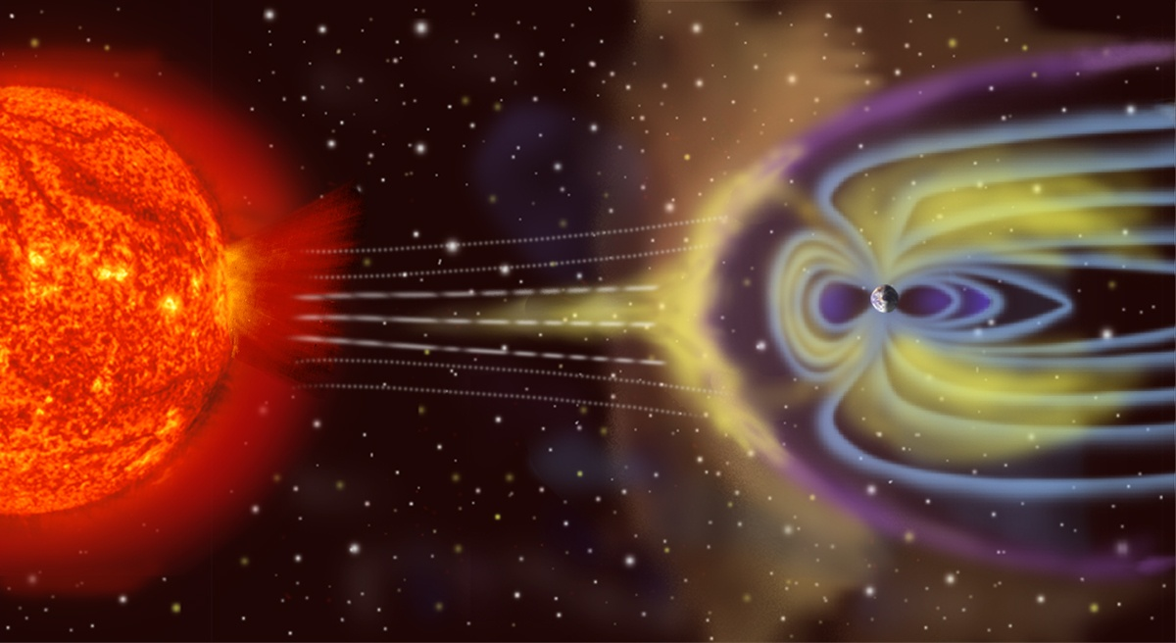
Meiri virkni sólar meiri norðurljós og óstöðugleiki
Norðurljósaindex mt. 2002 5,6 en 2010 4,2 stdev 2

Slide 4
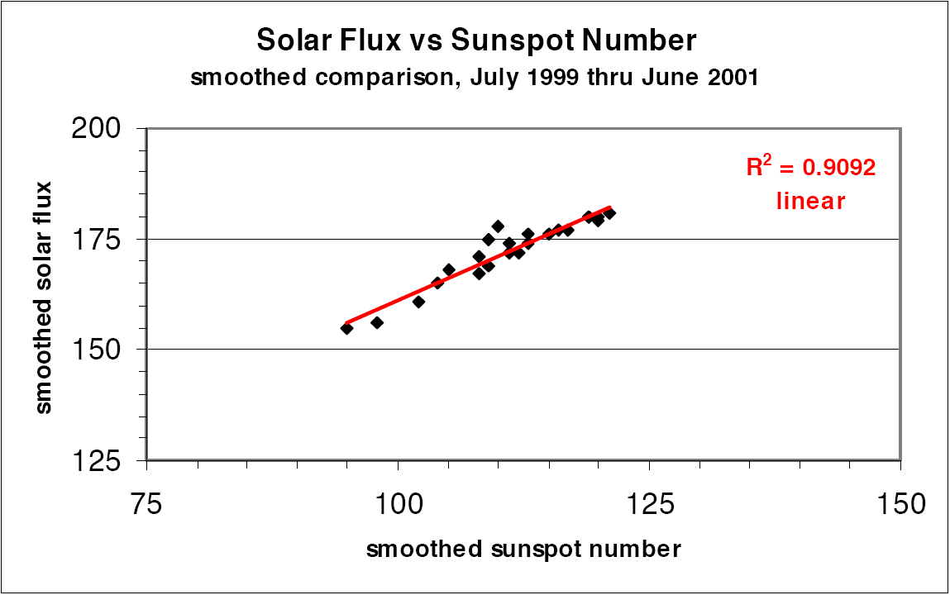
Heimild: Carl Luetzelschwab K9LA, mars 2002

Slide 5
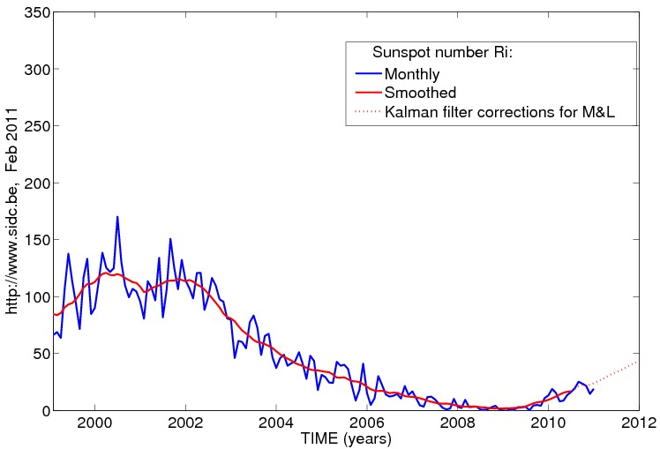
Heimild: Solar Influences Data Analysis Center

Slide 6
Aurora–Norðurljós–Dagar á ári
Ísland 243
Shetlandseyjar 100
Norður Skotland 50
Mið England 10
Norður Frakkland 5
Suður Frakkland 1

Slide 7
Contests

Slide 8
CQWW CW 160
2010
SunSpots: 9
Aurora (av): 4.49

Slide 9
Call | Q´s | US/VE | DXCC | Score
CN2R | 1810 | 56 | 89 | 2.604.055
CR2X | 1586 | 58 | 73 | 1,468,772
TF4X | 1575 | 51 | 78 | 1,234,401
DJ1YFK | 1587 | 50 | 78 | 1,172,864
GW3YDX | 1524 | 49 | 76 | 1,147,875
G3TXF | 1435 | 48 | 71 | 1,027,565
OHØX | 1410 | 47 | 69 | 1,002,124

Slide 10
SunSpots: 12
Aurora (av): 2.05
      ARRL CW
      6 TF stöðvar sendu inn logga

Slide 11
Call | Class | Q´s | Mults | Score
TF3DC | SOAB | 409 | 140 | 170.520
TF8GX | SOSB15 | 471 | 52 | 71.604
TF3CW | SOSB20 | 1739 | 59 | 306.210
TF3G | SOSB20 | 80 | 30 | 6.660
TF3Y | SOSB40 | 567 | 56 | 94.248
TF4M | SOSB160 | 369 | 55 | 59.730

Slide 12
ARRL CW SOSB20 WorldWide
Call | Q´s | Mults | Score
GM3POI | 1878 | 60 | 330.600
F6ARC | 1846 | 59 | 324.264
EA8CMX | 1760 | 59 | 315.237
TF3CW | 1739 | 59 | 306.210
DP4K (DK3DM) |  |  | 278,100
OH8L (OH8LQ) |  |  | 276,120

Slide 13
ARRL CW SOSB160 WorldWide
Call | Q´s | Mults | Score
C6AUM | 736 | 57 | 123,291
KV4FZ |  |  | 113,100
V31YN (DJ4KW) |  |  | 112,347
ON4UN | 489 | 55 | 79,530
OM3BH |  |  | 67,872
OL7M (OK1DF) |  |  | 62,496
TF4M | 369 | 55 | 59,730

Slide 14
SunSpots: 4
Aurora (av): 3.91
ARRL SSB 2010
4 TF stöðvar sendu inn logga

Slide 15
Call | Class | Q´s | Mults | Score
TF3AO | SOAB | 105 | 46 | 14.076
TF3SG | SOAB | 134 | 34 | 13.464
TF3CY | SOAB | 44 | 28 | 3.444
TF3CW | SOSB20 | 1364 | 60 | 243.900

Slide 16
ARRL SSB SOSB20 WorldWide
Call | Q´s | Mults | Score
F6KHM | 3246 | 63 | 621.696
TM5C | 3092 | 63 | 583.632
S50K | 2396 | 62 | 442.680
TF3CW | 1364 | 60 | 243.900 (14.sæti)

Slide 17
RDXC
5 TF stöðvar sendu inn logga

Slide 18
Call | Q´s | DXCC | Obl | Score | Class
TF3DC | 62 | 40 | 14 | 15.336 | SOAB LP
TF1CW | 950 | 59 | 63 | 442.738 | SOSB7
TF4M | 211 | 28 | 47 | 98.850 | SOSB20
TF3AO | 126 | 36 | 40 | 60.572 | SOSB20
TF4M | 81 | 23 | 15 | 13.680 | SOSB160

Slide 19
SunSpots: 21
Aurora (av): 3.96
CQ WPX SSB
4 TF stöðvar sendu inn logga

Slide 20
Call | Q´s | Mult | Score | Class
TF3AO | 540 | 371 | 280.847 | SOAB HP
TF3SG | 218 | 174 | 101.790 | SOAB HP
TF8GX | 874 | 457 | 601.869 | SOAB (T)
TF1CW | 440 | 318 | 323.088 | SOSB40

Slide 21
Heimasíða er niðri.
SunSpots: 15
Aurora (av): 7.99
              CQ WPX CW
              Engin TF stöð ?

Slide 22
SunSpots: 18,5
Aurora (av): 2.06
    IARU
    3 TF sendu inn logga

Slide 23
Call Class Pts
TF3HQ SO CW HP 156.692
TF4X M/S Mixed Mode 629.530
TF8GX SO Phone LP 46.314
HQ stöðvar verða að vera innan sama ITU zone. SK9HQ hafði 12 stöðvar í gangi vítt og breitt um SM-land. 5958 CW Q´s og 6027 SSB Q´s, gaf yfir 17.7 mil pts.
Mjög skemmtileg 24 klst keppni, en hún er í júlí.Þáttaka eykst með hverju ári. 3717 loggar 2010.

Slide 24
IOTA
2 TF stöðvar sendu inn logg ?
Call Q´s Mults Pts
TF7X M/S 1833 218 2.546.022
TF3CW 336 37 63.936
Skemmtileg 24 klst keppni, þar sem EU–021, og EU – 071 (Vey), EU-168 (Coastal) eru mults.
Sunspots: 27.5 Aurora (av): 4.24

Slide 25
SunSpots: 34.5
Aurora (av): 2.88
SAC CW
4 TF stöðvar sendu inn logga.

Slide 26
Call | Class | Q´s | Mults | Score
TF3W | SOAB HP | 2013 | 199 | 951.419
TF/DF1LON | SOAB LP | 551 | 97 | 117.079
TF/DL2JRM/P | SOAB QRP | 524 | 103 | 118.860
TF2JB | SOSB 20 | 45 | 13 | 1.456

Slide 27
SunSpots: 9
Aurora: 3.02
    SAC SSB
    2 TF stöðvar sendu inn logga

Slide 28
1. sæti í Skandinavíu
Til hamingju Gulli !!!!
Call | Class | Q´s | Mults | Score
TF8GX | SOAB LP | 1239 | 154 | 422.730
OG6N |  | 872 | 150 | 273.600
OH1LEG |  | 597 | 135 | 174.825
OH3LB |  | 676 | 99 | 138.204
TF3AO |  | 10 | 4 | 40

Slide 29
Breakdown SAC CW
OH4A í 4. sæti
TF3W í 11. sæti

Slide 30
Call | Band | Q´s | DXCC | Call | Band | Q´s | DXCC
TF3W | 80 | 104 | 28 | OH4A | 80 | 419 | 46
 | 40 | 614 | 57 |  | 40 | 660 | 58
 | 20 | 903 | 62 |  | 20 | 832 | 67
 | 15 | 390 | 50 |  | 15 | 408 | 64
 | 10 | 2 | 2 |  | 10 | 65 | 23
Total |  | 2013 | 199 |  |  | 2384 | 259
TF3W | Band | Ant |  | OH4A | Band | Ant
 | 80 | Inv V |  |  | 80 | 2 el | 50mH
 | 40 | Hustler |  |  | 40 | 3el | 40mH
 | 20 | Stepp |  |  | 20 | 5-5-5 | 20-40-60
 | 15 | Stepp |  |  | 15 | 6-6 | 15-30
 | 10 | Stepp |  |  | 10 | 7-7 | 10-20

Slide 31
TF3W markmið í SAC
1. Að komast í “Topp 5” í Skandinavíu,
í flokknum SOAB HP, bæði CW og SSB.
2. Bæta 80 m loftnet. ¼ wave GP á þaki, byggt á Spiderpole? Eða…….?
3. Bæta 40 m loftnet: 2 el. Yagi að láni.
4. Magnari til vara. Tæki til vara. Tölva til vara.
5. “All Out” effort í 24 tíma.

Slide 32
Scandinavian Cup CW/SSB
Nr. | Land | Loggar | Score
1 | Svíþjóð | 292 | 44.323.839
2 | Finland | 139 | 36.047.262
3 | Noregur | 66 | 7.229.178
4 | Danmörk | 39 | 4.961.730
5 | Álandseyjar | 8 | 4.543.473
6 | Ísland | 6 | 1.611.586
7 | Færeyjar | 3 | 543.896
8 | Grænland | 1 | 507.964
9 | Svalbarði | 1 | 332.785
10 | Market Reef | 1 | 13.615

Slide 33
CQWW RTTY
5 TF stöðvar sendu inn logga

Slide 34
Call | Class | Score
TF3AM | SOAB HP | 683.271
TF3IG | SOAB HP | 568.832
TF3AO | SOAB HP Ass | 417.701
TF3PPN | SOAB HP Ass | 279.441
TF8SM |  | 0

Slide 35
SunSpots: 25
Aurora (av): 2.67
CQWW SSB
7 TF stöðvar sendu inn logga.

Slide 36
Call | Class | Score
TF3Y | SOAB | 310.284
TF3AM | SOAB | 295.865
TF8GX | SOAB LP | 47.264
TF3IG | SOAB ASS | 15.456
TF3AO | SOSB15 ASS | 37.931
TF3CW | SOSB20 | 1.071.785
TF3SG | SOSB160 | 84.360

Slide 37
CQWW SSB SOSB160
Call | Score
RA9FW/9 | 131.912
M8M | 102.505
ES5RW | 86.913
TF3SG | 84.360

Slide 38
SunSpots: 12.5
Aurora(av): 4.09
CQWW CW
7 TF stöðvar sendu inn logga.

Slide 39
Call | Class | Score
TF3SG | SOAB ASS | 759
TF3IG | SOAB ASS | 0
TF8GX | SOAB LP | 37.510
TF3DC | SOAB LP ASS | 168.672
TF3AO | SOSB LP ASS | 8.113
TF3CW | SOSB40 ASS | 831.360
TF4M | SOAB160 ASS | 159.783

Slide 40
CQWW SSB TF Records
Band | Call | Q´s | Zones | DXCC | Score | Year
A | TF1MM | 2883 | 76 | 206 | 1.949.184 | 1990
28 | TF3MA | 486 | 20 | 42 | 70.060 | 1968
21 | TF2WLS | 682 | 20 | 66 | 117.218 | 1969
14 | TF3CW | 4107 | 34 | 126 | 1.791.840 | 1988
7 | TF3CW | 1624 | 31 | 109 | 454.580 | 1992
3.7 | TF3CW | 42 | 6 | 24 | 1.080 | 2007
1.8 | TF3SG | 97 | 8 | 40 | 4.800 | 2009
MS | TF3IRA | 3642 | 92 | 301 | 2,778,117 | 1980

Slide 41
CQWW CW TF Records
Band | Call | Q´s | Zone | DXCC | Score | Year
A | TF3WW (OH4NRC) | 4102 | 105 | 311 | 3.606.304 | 1988
28 | TF3YH | 1722 | 23 | 74 | 366.757 | 1981
21 | TF3IRA (TF3CW) | 2224 | 30 | 106 | 463.896 | 2002
14 | TF3CW | 2442 | 35 | 106 | 740.250 | 1991
7 | TF3CW | 1592 | 27 | 97 | 288.672 | 2008
3.5 | WA6EGL/TF | 203 | 14 | 36 | 18.200 | 1971
1.8 | TF3EJ | 427 | 11 | 41 | 34.684 | 1995

Slide 42
CQWW CW TF Records
Band | Call | Q´s | Zones | DXCC | Score | Year
LA | TF3GB | 2131 | 66 | 215 | 1.020.757 | 2003
L3.5 | TF2JB | 243 | 9 | 44 | 14.416 | 2008
Q28 | TF3MA | 24 | 13 | 19 | 1.344 | 2001
Q21 | TF3MA | 125 | 17 | 48 | 12.480 | 2002
AA | TF3VS | 265 | 57 | 182 | 117.110 | 2002
MS | TF4X | 4410 | 106 | 345 | 3.233.670 | 2009
M2 | TF4M | 3986 | 103 | 397 | 2.785.000 | 2005
MM | TF3IRA | 10.210 | 134 | 445 | 10.358.889 | 1997

Slide 43
CQWW 160 2011
3 TF stöðvar sendu inn logga

Slide 44
2.5 wött á 160, og það í Contest !
Call | Q´s | US/VE | DXCC | Score
TF4X | 1531 | 42 | 77 | 1.056.244
TF3SG |  |  |  | 151.316
TF3DX/M | 172 | 13 | 42 | 51.728

Slide 45
CQWW 160
2010 – 2011 frá TF4X
(samanburður)

Slide 46
TF4X (2010-K3BU) var nr.3 WorldWide
TF4X (2011-K5NA) verður líklega neðar en 10. sæti WorldWide…...(sjá 3830)
Call | Q´s | US/VE | DXCC | Score
TF4X (2010) | 1575 | 51 | 78 | 1,234,401
TF4X (2011) | 1531 | 42 | 77 | 1.056.244

Slide 47
CQWW RTTY WPX
2. TF stöðvar hafa sent inn logga

Slide 48
Call | Q´s | WPX | Score
TF3AO | 853 | 502 | 958.318
TF3PPN | 572 | 356 | 445.356

